Slide 1
Designing a lightweight, scalable, pluggable
Model-View-Controller (MVC) Web Application Framework
Ananth Balasubramanyam
MS Project
Fall 2008
Computer Science Department
Old Dominion University

Slide 2
Overview
Introduction
JSP Model 1 & Model 2 Architectures
MVC Framework Requirements
Controller Servlet
Database Connection Pool, System Cache & Application Environment
Application Security & User Session
Presentation Templates & Views
Developer Build Environment
Conclusion

Slide 3
Introduction
Web Applications serving dynamic content
JSPs - Pre-eminent Java Technology
Model 1 & Model 2 Architectures
Model-View-Controller Paradigm
MVC Frameworks Comparison
Building Scalable Solutions
Developer Build Environment

Slide 4
MVC Frameworks Comparison
 | Pi Project | Niggle Framework | Easywaf | My Framework
MVC Framework |  |  |  | 
Integrated Build Environment |  |  | ❒ | 
Database Connection Pool | ❒ |  |  | 
Custom Hooks | ❒ | ❒ | ❒ | 
System Cache | ❒ | ❒ | ❒ | 
System Preferences | ❒ | ❒ | ❒ | 
Role Based Access | ❒ | ❒ | ❒ | 
Application Security | ❒ | ❒ | ❒ | 

Slide 5
JSP Model 1 Architecture
Easy to implement
JSP Centric - JSPs heavily used
Code Maintenance
Request Handling
Form Submissions

Slide 6
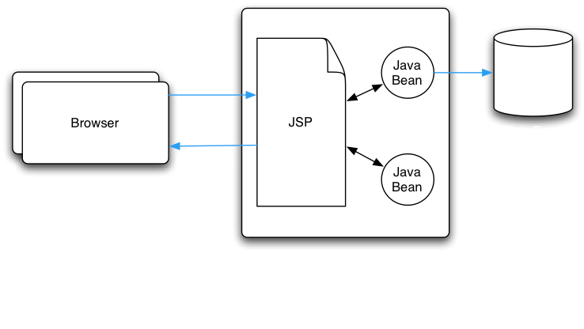
JSP Model 1 Architecture

Slide 7
JSP Model 2 Architecture
Layered Architecture
Highly Scalable
Easy Maintenance
Separation of Responsibilities
Presentation & User Interaction
Data Access & Business Logic
Core Framework

Slide 8
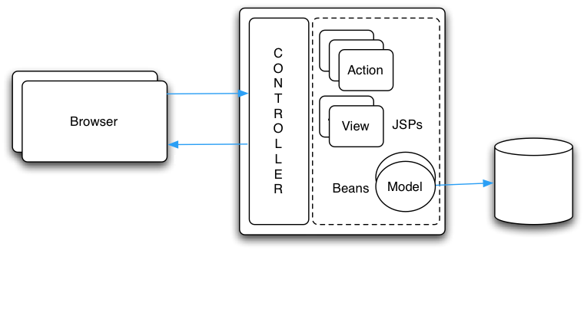
JSP Model 2 Architecture

Slide 9
MVC Framework Requirements
Lightweight, Scalable & Pluggable Architecture
Presentation - Reusable Templates for generating Views
Typical Web Application Requirements
Database Connection Pool
System Cache
System Preferences
Application Security
Restricted Role Based Access
Low Memory Footprint
Integrated Build Environment

Slide 10
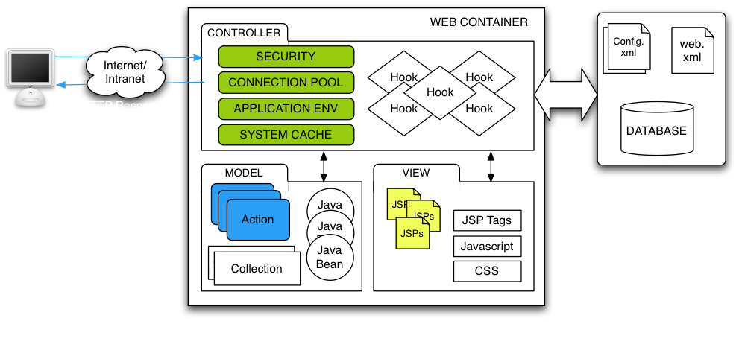
MVC Web Application Framework

Slide 11
Controller Servlet
config.xml
Security Hook
is request secure ?
HTTP Request
N
Faculty.do?invoke=List
LoginERROR
Y
Action Map
Action Class
Login | my.actions.Login
Faculty | my.actions.Faculty
........... | ...........
Admin | my.actions.Admin
Faculty.java
list()
Resource Map
ListOK
ListOK | /faculty/teacher_list.jsp | main
DetailsOK | /faculty/teacher_details.jsp | main
........... | ........... | .........
ListERROR | /faculty/error.jsp | main
View
teacher_list.jsp
+
template-main.jsp
HTTP Response
(JSPs + Javascript + CSS)
login_form.jsp

Slide 12
Database Connection Pool
Initialized on Start-up
Used By Action Classes
Manages Connections Effectively
De-allocates on Shut-down
Application Accessibility
Connection Recycling
Connection Properties
Connection Pool Settings
Multiple Database Connections

Slide 13
System Cache
Initialized on Start-up
Application Wide Cache
Caches frequently accessed Data
Multiple Use-Cases
User Cache
Static Lookup Data
Dictionary Cache
Charts/Graphs
Application Read-Only Data

Slide 14
Application Environment
Deployment Configuration
WEBSERVER=catalina
Database Connection Settings
Connection Pool Settings
DATABASE.DRIVER=org.postgresql.Driver
DATABASE.URL=jdbc:postgresql://127.0.0.1:5432/istart
  Secure File Library Settings
DATABASE.USER=postgres
DATABASE.PASSWORD=postgres
DATABASE.TYPE=postgres
CONNECTION_POOL.DEBUG=true
CONNECTION_POOL.TEST_CONNECTIONS=false
CONNECTION_POOL.ALLOW_SHRINKING=true
CONNECTION_POOL.MAX_CONNECTIONS=10
CONNECTION_POOL.MAX_IDLE_TIME.SECONDS=60
CONNECTION_POOL.MAX_DEAD_TIME.SECONDS=300
APP.FILES.PATH=C:/tomcat/webapps/istart/WEB-INF/files

Slide 15
Application Security
HTTP Request
Faculty.do?invoke=List
Username/Password Login Scheme
MD5 One-way Password Encryption
Login
Tracks Expired & Archived Users
Security Hook Check for Valid Sessions
User Roles & Permissions
Security Hook
Module Access
R&P
HTTP Response

Slide 16
Presentation Templates & Views
Technologies Used - JSPs, JSTL, CSS & Javascript
Framework Support
  Controller Main Menu Hook
  JSP Templates & Embed JSPs to generate Views
  JSP Custom Tag Libraries (e.g: selectDate, tabs, username)
  Display/Print CSS Files & Reusable Javascript Include Files
  Multi-Browser Support using Browser Detection Scripts
<istart:eval>
<istart:selectDate>
<istart:tabs>
MAIN MENU
SUB MENU
FACULTY LIST

Slide 17
A Simple Course
Management System

Slide 18
Course Management System
Courses, Departments, Faculty & Students
Actors - Students, Faculty & Admins
Secure Role Based Access (Add, Edit, View & Delete)
  Module Config: Role > Access Level Mapping
  <role constant=‘admin’ module=‘faculty’ access=‘VAED’>
  <role constant=‘student’ module=‘faculty’ access=‘V’>
Handle Database Resources Effectively
  Connection db = Framework.getConnection();
  Framework.freeConnection(db);
System Cache - Easy access to static and frequently used information
  SystemCache.getUser(int ID);
  SystemCache.getLookup(“lookup_department”);
System Preferences - Deployment Specific Preferences
  AppPreferences.getPref(“XXX”);
Integrated Build Environment
  ant compile, ant deploy, ant war

Slide 19
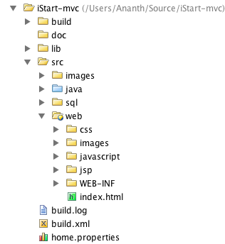
Developer Build Environment
Source Code Directory Structure
Apache Ant - Web Application Build Process
Build configuration with build.xml & home.properties

Slide 20
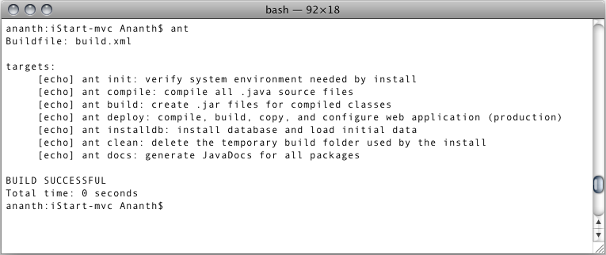

Slide 21
Conclusion
A Lightweight, Scalable MVC Web Application Framework
Developer Focus
Integrated Build Environment
Secure Role Based Access Framework
Developer Getting Started
3rd Party References
ConnectionPool.java -- http://www.coreservlets.com
Calendar Date Selector -- http://www.mattkruse.com/
Apache Ant -- http://ant.apache.org/
OpenOffice Icons - GPL

